Slide 1
Digital Inclusion for Inclusive growth
Laveesh Bhandari
IAMAI, Mumbai, September 9, 2014

Slide 2
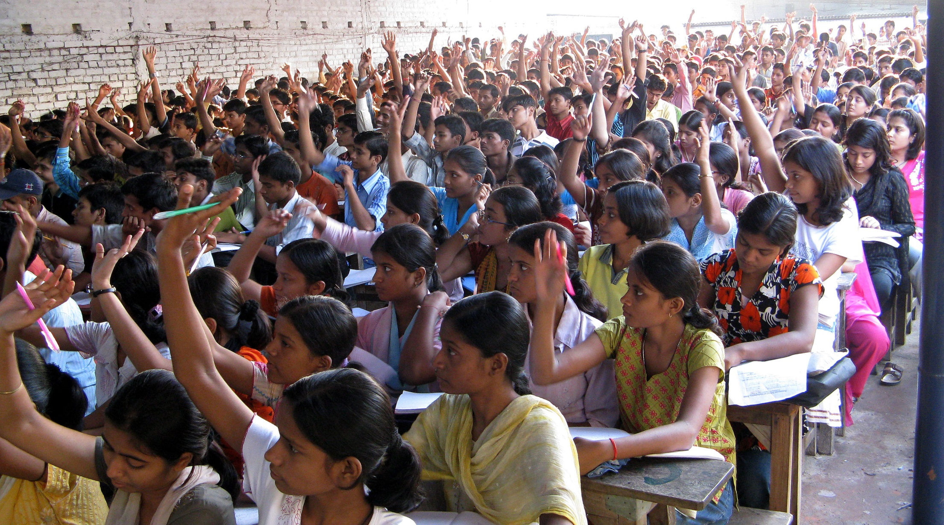
Inclusive growth = opportunities for all

Slide 3
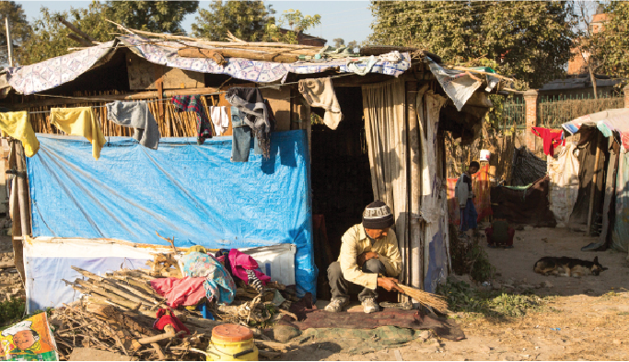
+ the capability to avail them

Slide 4
Digital inclusion could be the answer

Slide 5
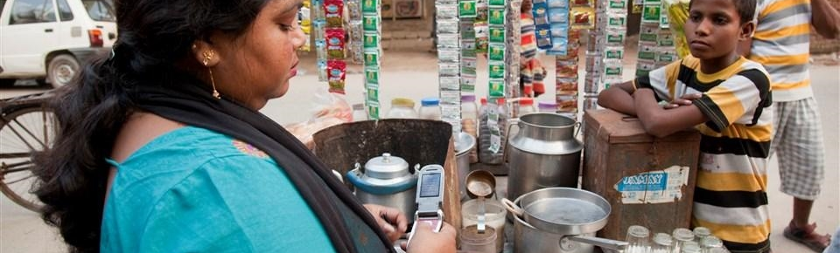
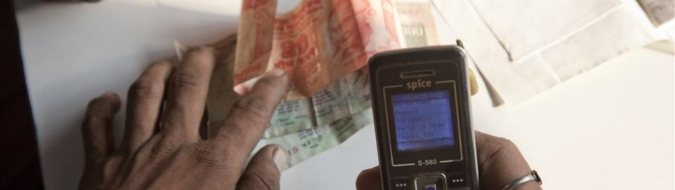
Accessible Services NOT Simply Infrastructure Availability

Slide 6
Thankfully there is a solution
Adhaar will not tell who & where

Slide 7
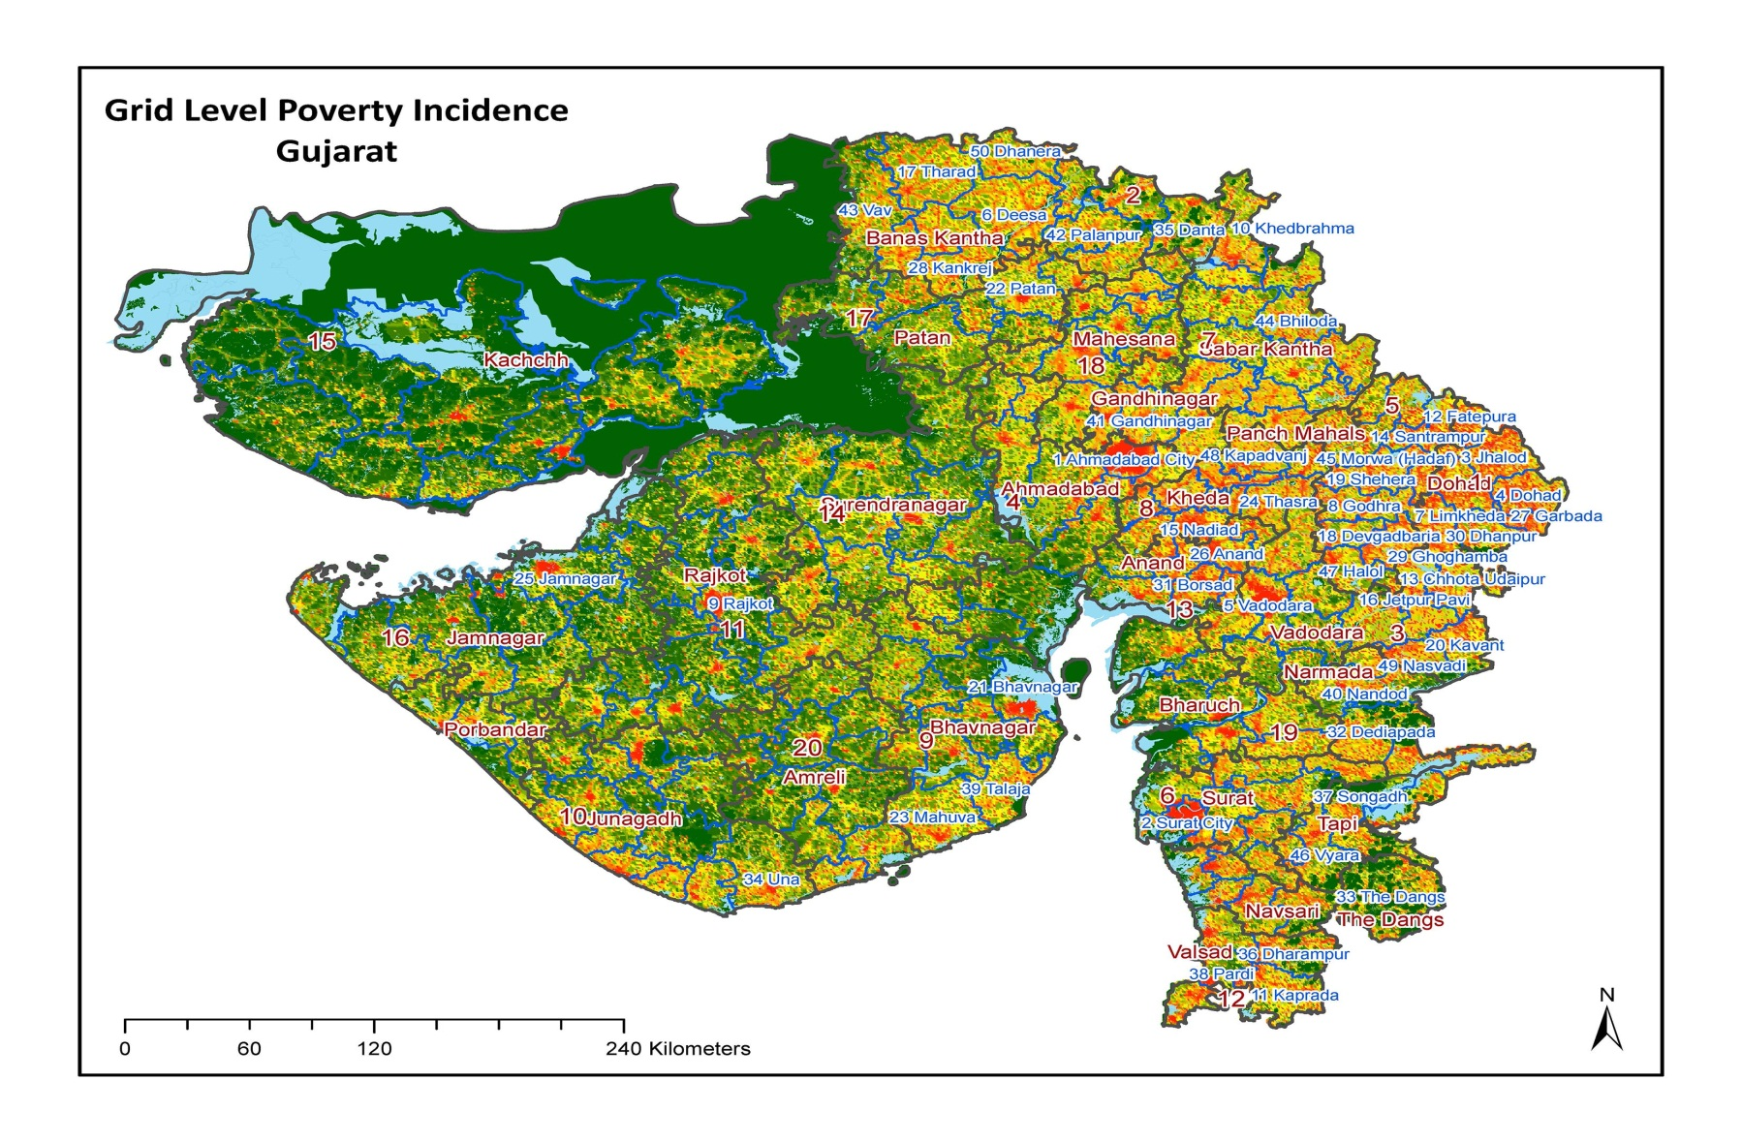
Digital era technologies
Satellite imagery + big data techniques

Slide 8
Policy for open-ness and innovation
Language
Financial inclusion
Working minimum infrastructure
Downtime, speeds, complete coverage, customer redressal
Service orientation
Economical regulation
Prevention is not necessarily better than cure
Coordinated approach

Slide 9
Thank You

